Slide 1
Investment Simulation & Forecasting
Presented by Alex Abraham, Amir Nabiyev, Azim Rahat, Md Mamun, Wen Jie Long
Fall 2025 CSc 46000

Slide 2
Agenda
Introduction and Problem Statement
Method and Process
Data Collection
Modeling or Analytical Approach
Presenting Insights

Slide 3
INTRODUCTION AND PROBLEM STATEMENT

Slide 4



Forecasting Future Performance of Major Stock Indices Using Machine Learning.
Investors face uncertainty when choosing which major U.S. stock index offers the best long-term potential
We’ll use 10+ years of market data from stock APIs and apply machine learning to forecast future performance.
Python models and Tableau dashboards will reveal which index shows the strongest growth and stability.
Notes:
Looks like we pick one or the other

Slide 5
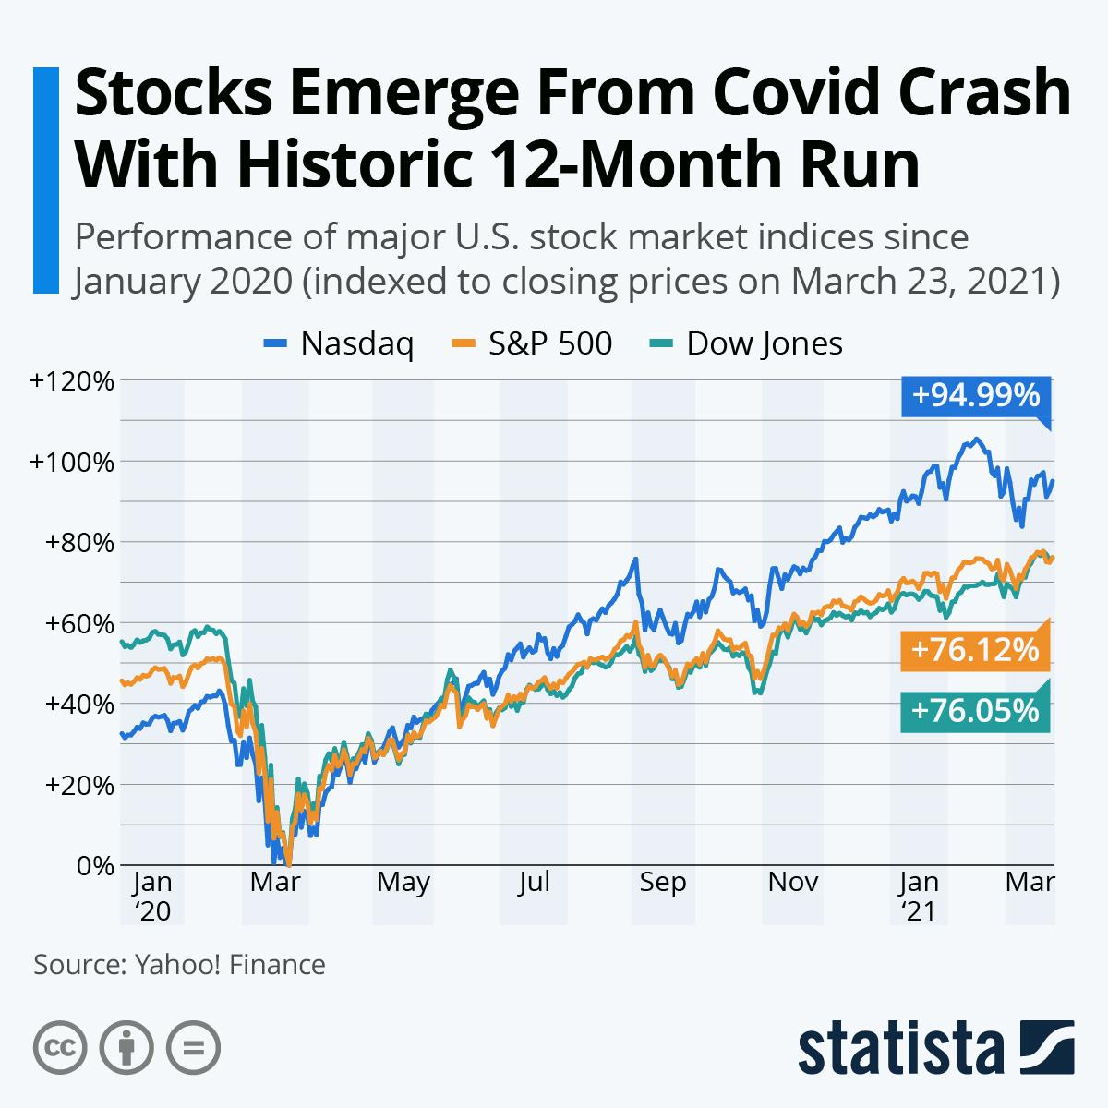
Can we forecast the future performance of major stock indices (S&P 500, NASDAQ, Dow Jones) to determine which offers the best investment potential?
Index funds and Exchange-Traded Funds (ETF) rely on stock index performance
Tracking performance is important to judging volatility and risk
Knowing which indices are better can yield better returns
Being able to automate performance analytics means lower costs

Slide 6


Introduction and Problem
Project background and context
Problems you want to find answers
There are many different indices. For example, the top 3 followed indices in the US are Standard & Poor’s 500, the Dow Jones Industrial Average, and the Nasdaq Composite.
Different indices focus on different things. For example, Dow Jones focuses on “blue chip” companies, which are stable, publicly traded companies with long reputations.
What can we use to predict future performance? What different models can we apply?
What time range should we look at for different models?

Slide 7


Stakeholders and Measurable Goal
Stakeholders
Measurable Goal
ETF Managers
Retail Investors
Index Fund Providers
Financial Analysts
Forecast 5-year growth (2025–2030)
Compare SPY, QQQ, and AGG over the future
Highlight best index for growth + stability

Slide 8
METHOD AND PROCESS

Slide 9
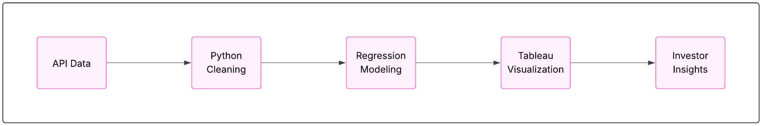
How we will Collect, Process, and Analyze the Data
How Our Process Works
Collect 10+ years of index price data using Polygon.io API
Clean & normalize data in Python (Pandas)
Apply Machine Learning Techniques (scikit-learn) to forecast performance
Visualize results using Tableau dashboards for comparison
Extract Investment insights
Journey Map

Slide 10
METHODOLOGY
Executive Summary
Data collection methodology:
Data will be collected from Polygon.io API covering 10+ years of daily closing prices for the S&P 500, NASDAQ, and Dow Jones indices
Perform data wrangling
Clean and format dataset using Python (Pandas), including cleaning nulls, aligning dates, and normalizing prices
Perform exploratory data analysis (EDA)
Conduct analysis to understand historical performance, volatility, and inter-index relationships
Modeling Approach
Apply Machine Learning techniques (scikit-learn) to forecast future performance based on historical closing prices
Train and validate the model using R² (variance) and RMSE (average prediction error) as metrics
Visualization and Insights
Build interactive Tableau dashboards to visualize predicted growth, stability, and returns for all three indices
Present key investment insights

Slide 11

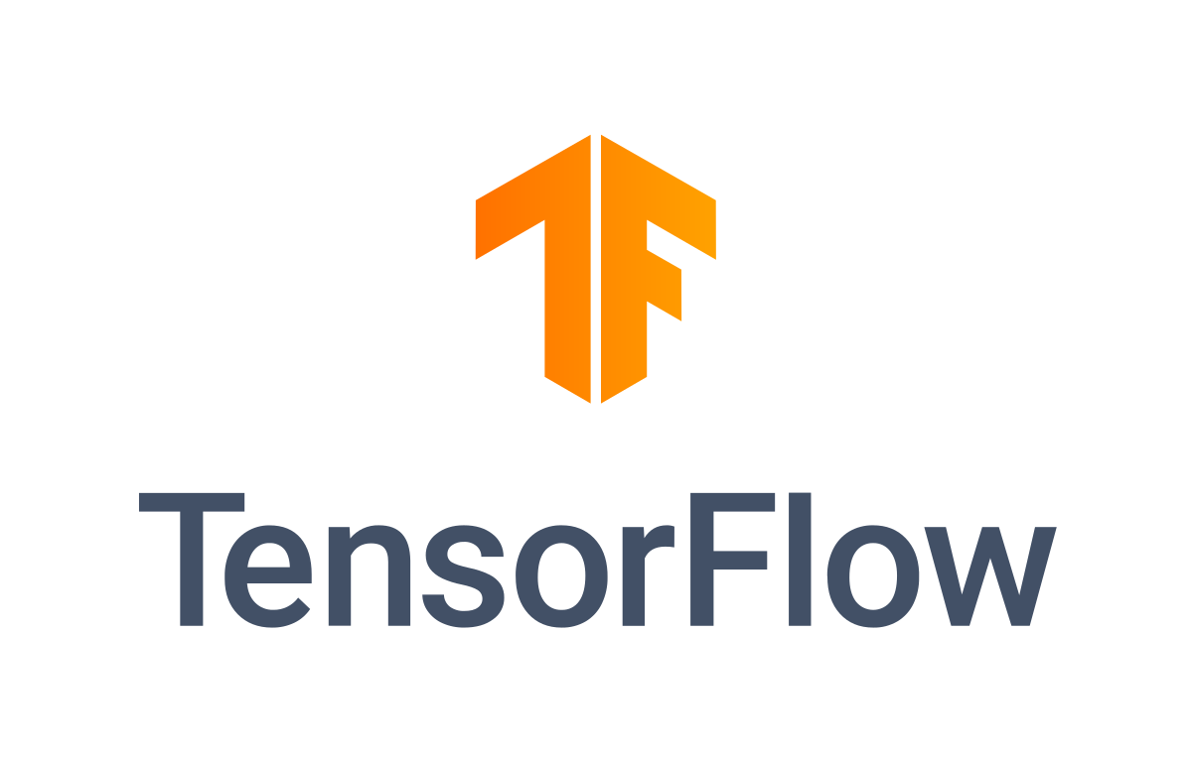

Which Machine Learning Techniques to apply?
Linear Regression
Recurrent Neural Networks
Random Forests

Slide 12
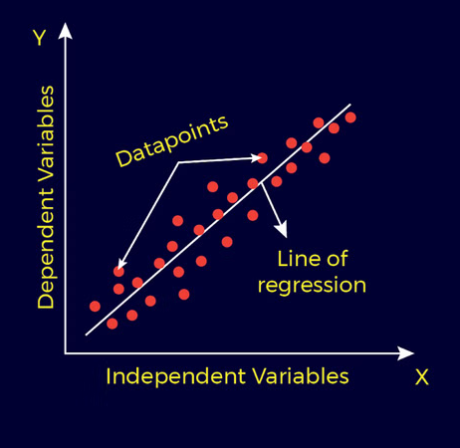
Why Linear Regression?
Predicts Trends Over Time
Can model long-term index movement using historical closing prices.
Works Well With Continuous Data
Ideal for forecasting numerical outputs like index prices or returns.
Interpretable Results
Model coefficients show how past performance impacts future trends.
Low Complexity, High Transparency
Easier to validate and explain than black-box models.
Baseline Model
Serves as a benchmark before testing advanced methods.
Cons
Simplicity, hard to model volatility
Assumes a linear relationship between variables

Slide 13
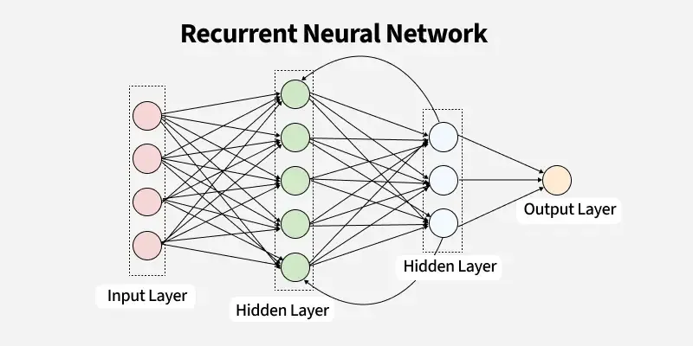
Why Recurrent Neural Networks (RNN)
Captures Temporal Dependencies
Learns from sequential patterns in time-series data like stock prices or returns.
Handles Nonlinear Relationships
Can model complex, nonlinear trends and interactions better than linear regression.
Adapts to Context and Memory
Retains information from previous time steps, improving short-term forecasting accuracy.
Integrates Multiple Inputs
Can incorporate additional features such as trading volume, sentiment, or macroeconomic data.
Cons
Requires large datasets and significant training time. Prone to overfitting and sensitive to hyperparameter tuning.

Slide 14

Why Random Forests?
Captures Nonlinear Relationships
Models complex interactions between features without assuming linearity.
Robust to Noise and Outliers
Ensemble of decision trees averages results, reducing sensitivity to extreme values.
Feature Importance Insights
Provides interpretable rankings of which factors most influence stock price movements.
Handles High-Dimensional Data
Performs well even when using many correlated financial indicators or technical metrics.
Good Generalization
Less likely to overfit compared to single decision trees, offering stable performance on unseen data.
Cons
Limited ability to capture temporal dependencies; treats time steps as independent observations. Computationally expensive for large datasets.

Slide 15
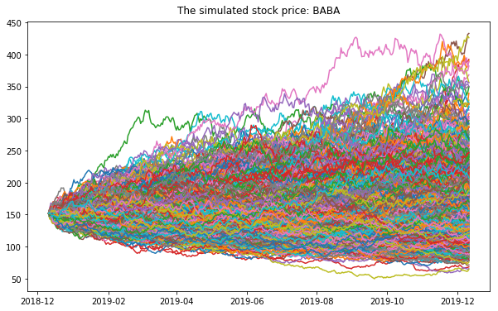
Monte Carlo Simulations
Quantifies Prediction Uncertainty
Runs thousands of randomized simulations to estimate a range of possible outcomes instead of a single value.
Captures Market Volatility
Models randomness in stock returns, volatility, or interest rates to reflect real-world fluctuations.
Averages Model Estimates
Generates a probability distribution of predictions, helping identify expected value and confidence intervals.
Supports Risk Assessment
Used to estimate Value at Risk (VaR), expected shortfall, and other probabilistic risk measures.

Slide 16
DATASET

Slide 17
DATA COLLECTION
We plan to collect our data using live financial APIs
Using GET requests to the Polygon.io API, we will retrieve 10+ years of daily historical prices for the S&P 500, NASDAQ, and Dow Jones indices
We will decode the API response as JSON and convert it into a Pandas DataFrame, organizing columns with date, open, close, high, low, volume
We will then clean the data, handling any missing values or misaligned dates
To help with our regression analysis, we plan to calculate daily returns and percent changes for each index in our processing
The cleaned dataset will feed into Tableau through a live connection for visualization

Slide 18
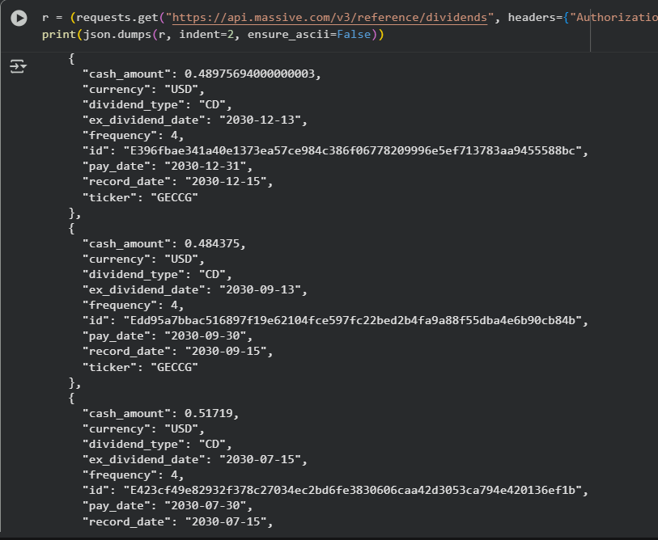
Polygon.io API
Retrieved data using a GET request with Bearer token
Shows payout trends across companies
Adds context to index performance

Slide 19
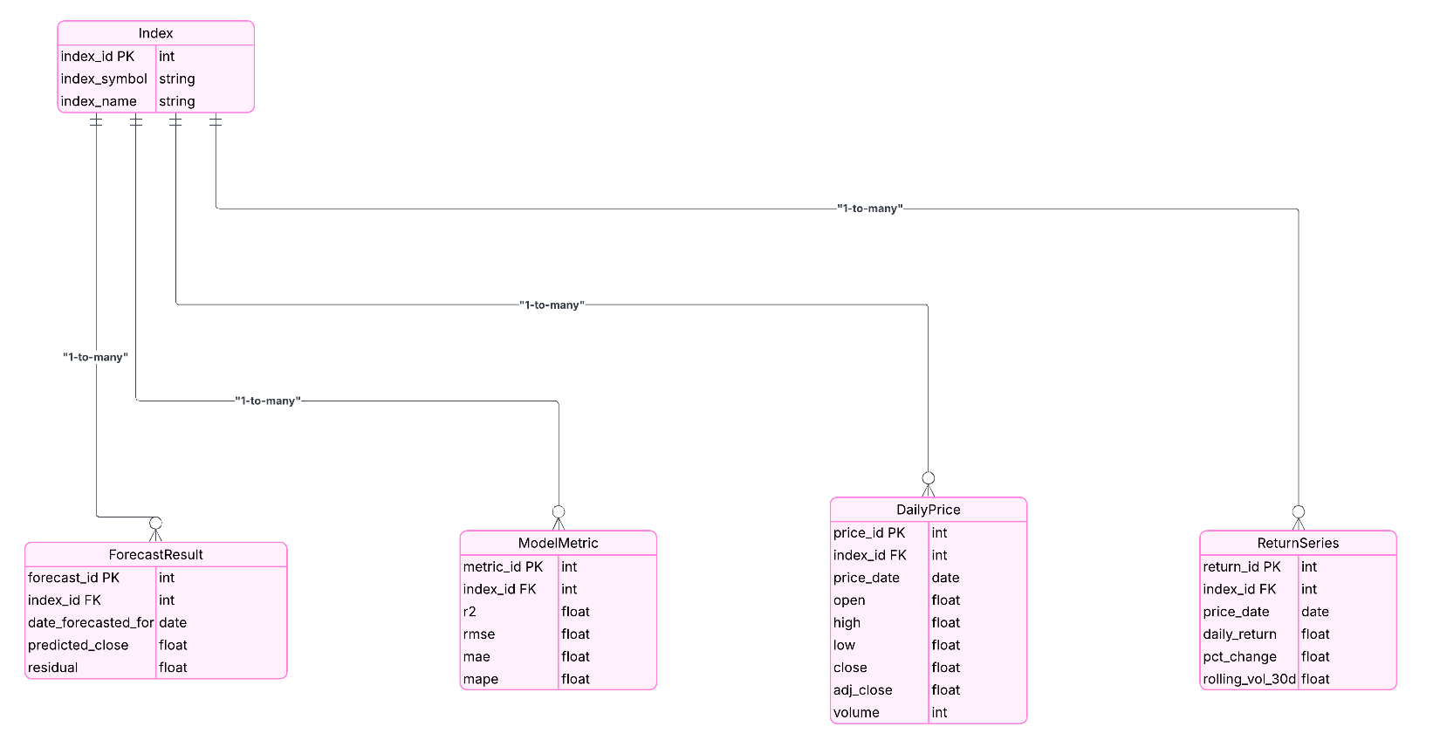
THE DATA MODEL
Notes:
Index: table stores the three market indices (S&P 500, NASDAQ, and Dow Jones ) acts as the master reference for the entire db.useful in Tableau for filtering and comparing performance across indices.
Daily Price: Table contains the actual historical data we pull from the polygon.io api, storing each index’s daily open, high, close, and volume (used for our training data).
Will be used for the performance line in our tableau charts
Forecast Result: The models predictions will be stored here forecasting closing prices and diff between actual and predicted values. Can compare real vs predicted performance in Tableau
Model Metric: Each row is a summary of how well the model performed for a given metric, storing evaluation metrics like R^2, RMSE, MAE, and MAPE. Will be useful for powering KPI visualizations
Return Series: The table holds financial metrics calculated in Python like daily returns, percent changes, and the rolling 30 day volatility to help with our analysis. Also for volatility and risk comparison visuals in Tableau.

Slide 20
BUSINESS INTELLIGENCE

Slide 21
Our Tableau dashboard will visualize key insights from the Index, DailyPrice, ReturnSeries, ForecastResult, and ModelMetrics tables.
Each worksheet will connect to our PostgreSQL database for live analysis
We will fill the dashboard with:
Historical Data (DailyPrice): Used to model actual performance trend lines
Predicted Data (ForecastResult): For Forecasted Growth and Actual vs Predicted comparisons
Derived Metrics (Return Series): To model stability vs risk
Model Metrics (ModelMetric): To power KPI tiles showing R² and RMSE per index to measure model accuracy
Filters (Index): Allow dynamic switching between indices
Business Intelligence Dashboard

Slide 22
APPLICATION STACK

Slide 23
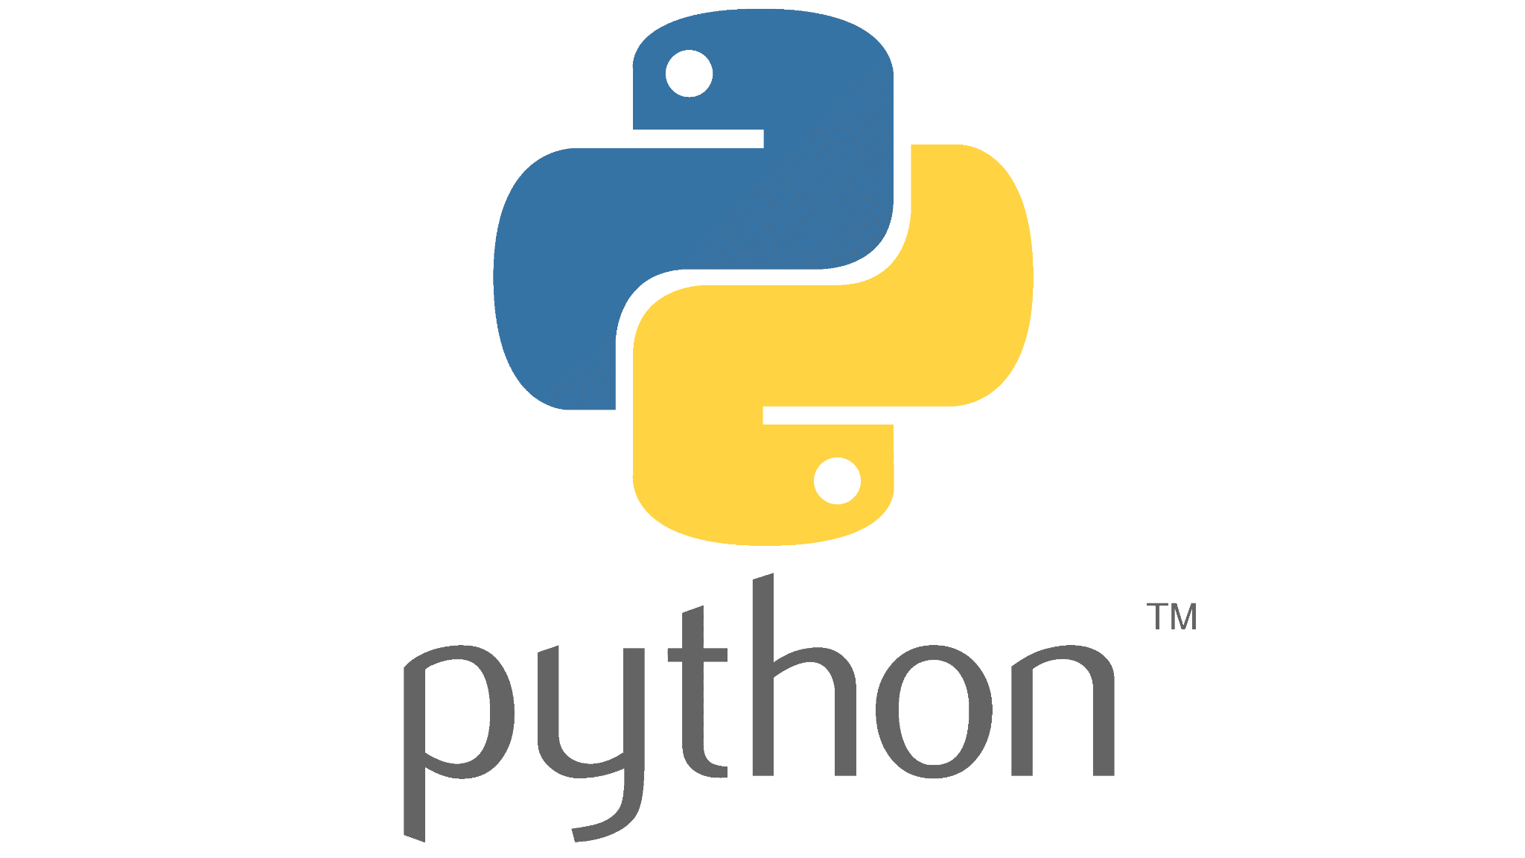

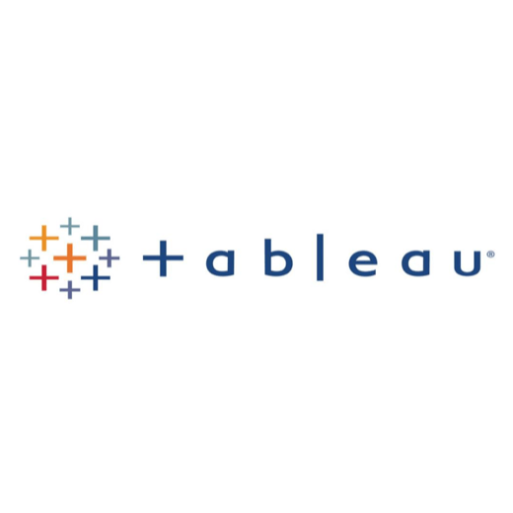

THE STACK
Data Source: Polygon.io
Processing: Python (Pandas (cleaning), scikit-learn (regression))
Storage: PostgreSQL
Visualization: Tableau
Notes:
APPLICATION STACK
Data Source: Polygon.io (live index data via API)
Processing: Python
Pandas – data cleaning & wrangling
scikit-learn – linear regression modeling
Storage: PostgreSQL database
Stores cleaned index price data
Enables live connection to Tableau
Visualization: Tableau (dashboards for forecast, returns, volatility)

Slide 24
Q&A

